Slide 1
DESCRIPTORS

Slide 2
A FEW TERMS FIRST…
EMS- Entity Management System
NF- Network Function
NFV- Network Function Virtualization
NFVI- NFV Infrastructure
NFVI-PoP- NFV Infrastructure Point of Presence
VNF- Virtualized Network Function
VNF-FG- VNF Forwarding Graph

Slide 3
WHAT IS A DESCRIPTOR?
According to the computing definition, a descriptor simply means:-
A piece of stored data that indicates how other data is stored.
It is then primarily a type of metadata.
Hence, when dealing with network descriptors, it means how the instances of the various components of network are stored.

Slide 4
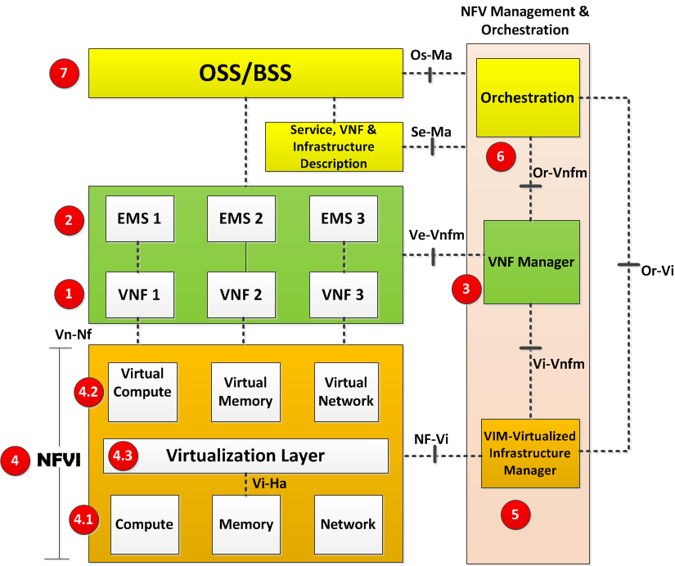
NETWORK UNDER CONSIDERATION
A typical network under consideration would look basically as shown.
There are a total of seven block in NFV or Network Function Virtualization, which are as follows:-
VNF (Virtual Network Function)
EMS (Element Management System)
VNF Manager
NFVI (Network Function Virtualization Infrastructure)
VIM (Virtualized Infrastructure Manager)
NFV Orchestrator
OSS/BSS(Operation Support System/Business Support System)

Slide 5
VNF MANAGER
A VNF Manager manages a VNF or multiple VNFs i.e. it does the life cycle management of VNF instances.
Life cycle management means
setting up VNFs or creating VNFs
maintaining VNFs
tearing down VNFs.
The interface through which it is controlled is named Ve-Vnfm.

Slide 6
VNF (Virtual Network Function)
A VNF is the basic block in NFV Architecture. It is the virtualized network element. For example when a router is virtualized, its called Router VNF.
Other examples of VNF include firewalls, IPS, GGSN, SGSN, RNC, EPC etc.

Slide 7
EMS (Element Management System)
This is the element management system for VNF.
This is responsible for the management of VNF operation, in the same way as physical network elements are managed by their respective EMS of VNFs.
There may be one EMS per VNF or an EMS can manage multiple VNFs.
EMS itself can be a VNF.

Slide 8
VIM (Virtualized Infrastructure Manager)
This is the management system for NFVI.
It is responsible for controlling and managing the NFVI compute, network and storage resources within one operator’s infrastructure domain.
It is also responsible for collection of performance measurements and events.

Slide 9
NFVI (Network Function Virtualization Infrastructure)
NFVI is the environment in which VNFs run.
Functions of this layer are as described below
Compute, Memory and Networking Resources- This is the physical parts in VNFI.
Virtual Compute, Virtual Memory and Virtual Networking Resources- This is the virtual part in NFVI.
Virtualization Layer- This layer is responsible for abstracting physical resources into virtual resources.

Slide 10
NFV Orchestrator
Generates, maintains and tears down network services of VNF themselves.
If there are multiple VNFs, orchestrator will enable creation of end to end service over multiple VNFs.
NFV Orchestrator is also responsible for global resource management of NFVI resources.
The Orchestrator performs its functions by NOT talking directly to VNFs but through VNFM and VIM.

Slide 11
OSS/BSS(Operation Support System/Business Support System)
OSS deals with network management, fault management, configuration management and service management.
BSS deals with customer management, product management and order management etc.

Slide 12
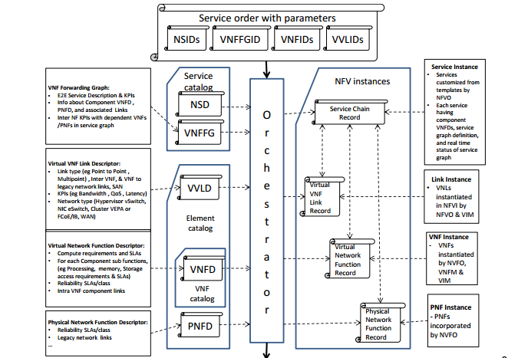
Overview of various descriptors of NFV-MANO

Slide 13
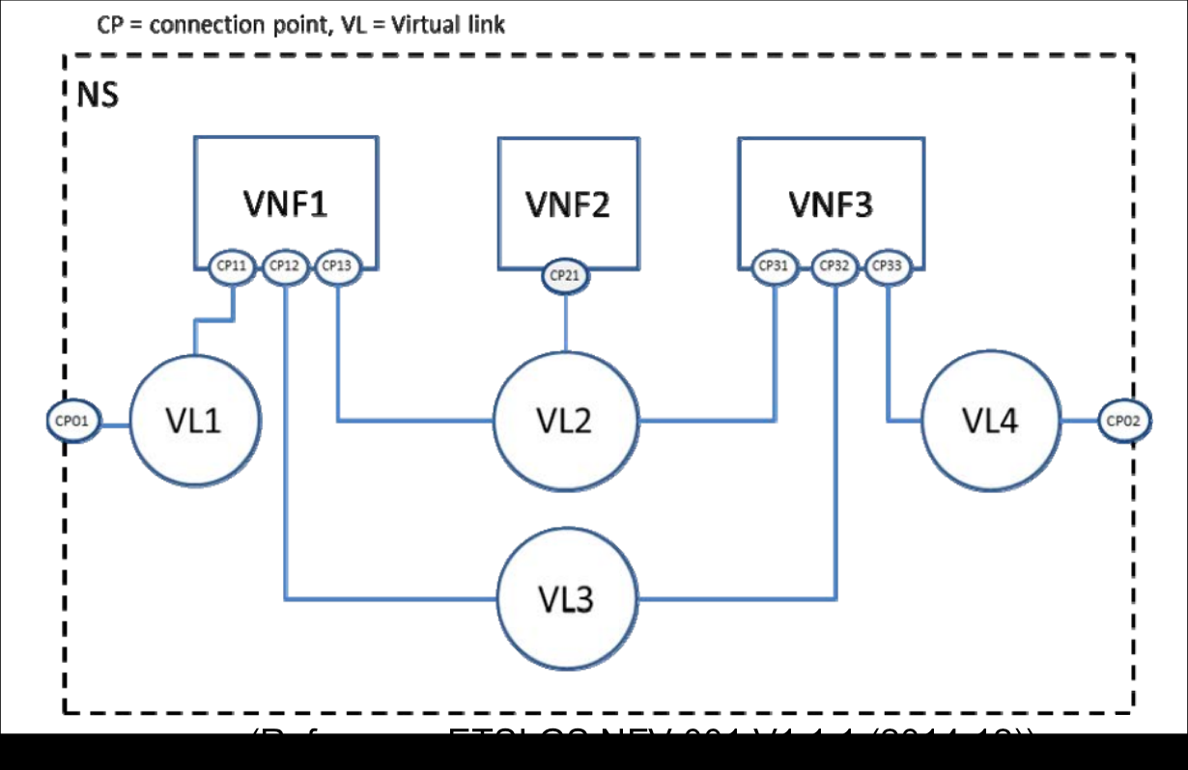
Network Service Descriptor
The NSD connects VNFs using the Virtual Links (VLs) as shown.
The VNFs attach to the VLs using the Connection Points (CPs). So the NSD captures the list of VNFs and the VLs that connect the VNFs.

Slide 14
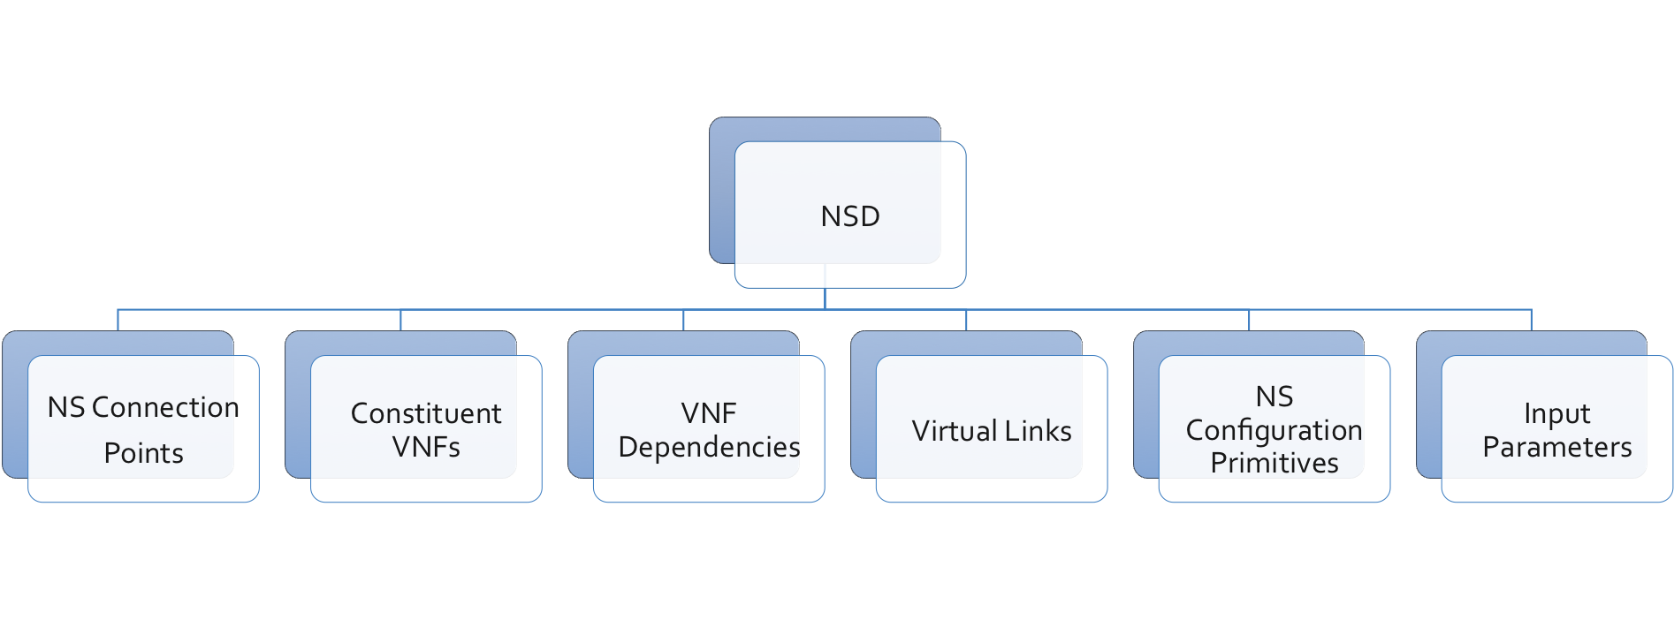
High Level Objects in NSD
NS Connection Points: List for network service (NS) connection points. Each NS has one or more external connection points used to link the NS to other NS or to external networks. Each NS exposes these connection points to the orchestrator. The orchestrator can construct network service chains by connecting the connection points between different NS.
Constituent VNFs: List of Virtual Network Function Descriptors (VNFDs) that are part of this network service.
VNF Dependencies: List of VNF dependencies. This specifies the order in which the VNFs inside the NS should be started.
Virtual Links: List of Virtual Link Descriptors (VLD). The VLD describes how VNFs in the NSD are connected. NS Configuration Primitives: Network Service level configuration primitives.
Input Parameters: List of paths for customisation.

Slide 15
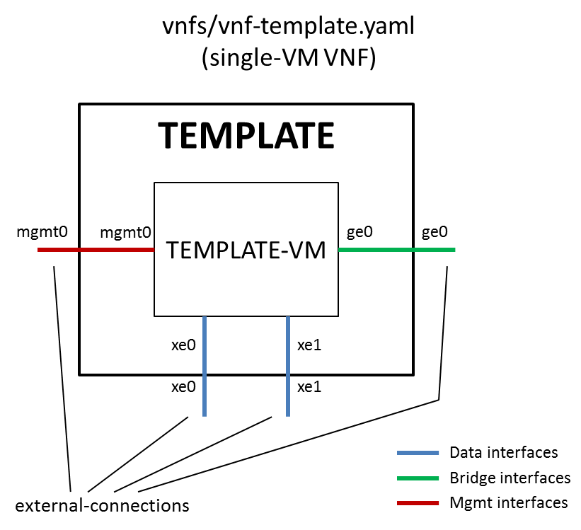
VNF Descriptor (VNFD) - Virtualized Network Functions Descriptor
It consists of the following:-
Unique name of VNF. No two VNFs have the same name.
External Connections – Describes how a VNF can be connected to other VNFs in the NS (Network Scenario).
Internal Connections – Defines how the internal components of the VNF are connected to each other.
Internally, the VNF Descriptor consists of the following:-
NUMA, CPU, memory and interface requirements
Bridge-ifaces
Devices
Vupus
RAM

Slide 16
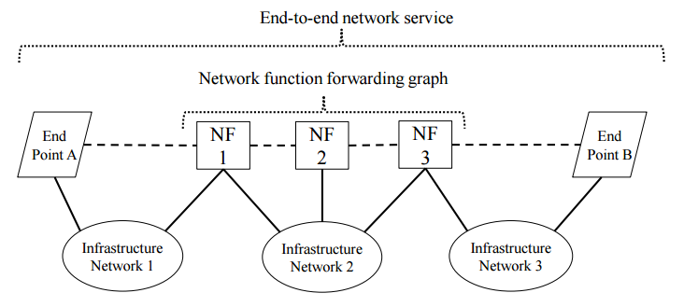
NFV Forwarding Graphs
An end-to-end network service can be defined as a forwarding graph of network functions and end points/terminals.

Slide 17
Features of NFV Forwarding Graphs
Efficiency. Compute resources assigned to function and network capacity sized to current load and shareable across functions.
Resiliency. In some cases, backup function and network capacity can be shared.
Agility. Shorter deployment intervals for upgrades and new features since functions are software based.
Flexibility. Reduce configuration complexity.

Slide 18
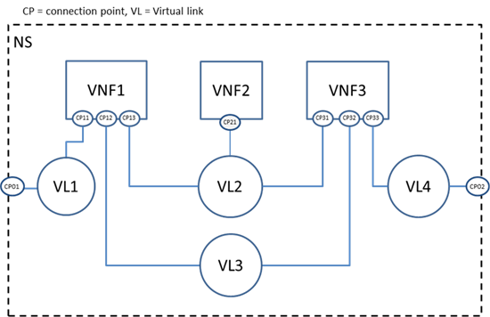
Virtual Link Descriptor
A Virtual Link Descriptor (VLD) is a deployment template which describes the resource requirements that are needed for a link between VNFs, PNFs and endpoints of the Network Service, which could be met by various link options that are available in the NFVI.
A Physical Network Function Descriptor (PNFD) describes the connectivity, Interface and KPIs(Key Performance Indicators) requirements of Virtual Links to an attached Physical Network Function.

Slide 19
THANK YOU

